Slide 1
CIS 11 – Computer Architecture
James Wilson

Slide 2
Literals
Integer
Format: [{ + | - }] digits [ radix ]
-45d, 45h, 10b
Real Numbers
Format: [{ + | - }] integer.[integer] [exponent]
+3.2, -5.3E3
Characters
‘A’, “A”
Strings
‘This is a sentence’, “This is actually an array of characters”

Slide 3
Expressions
A combination of one or more operators and one or more operands that returns a value
1 + 2
5++
5 – 3 * 2 / 1
Order of Precedence
PEDMAS / PEMDAS

Slide 4
Identifiers
Programmer-chosen name for a variable, constant, procedure, label, etc.
Must follow rules defined by the language specification
Variable:
In computer programming, a variable or scalar is a storage location (identified by a memory address) paired with an associated symbolic name (an identifier), which contains some known or unknown quantity of information referred to as a value.

Slide 5
Directives
Command to the assembler. Does not execute at runtime
Specific to the assembler (can differ among ASM implementations)
DWORD, COMMENT, IF, GOTO, etc
Segments
Specific type of directive
Breaks up program into sections that each have a different purpose

Slide 6
Instructions
NOT directives!
Executable statement
Format [label:] mnemonic [operands] [;comment]
Label = reference to the memory address of the thing it is before (variable or function)
Mnemonic = instruction
MOV, ADD, SUB, MUL, JMP, CALL
Operands = things to be operated on. Subject of the instruction
Comments = ???

Slide 7
Practice
.386
.model flat, stdcall
includelib \masm32\lib\user32.lib
.data
msg db "Hello world!!!", 0
cpt db "MY FIRST PROGRAM!!!", 0
.code
start:
invoke MessageBox, NULL, addr msg, addr cpt, MB_OK + MB_ICONINFORMATION
invoke ExitProcess, NULL
end start

Slide 8
Demo MASM w/ Debugger

Slide 9
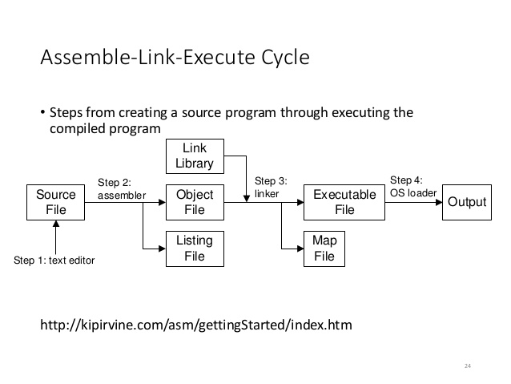
Assemble-Link-Execute Cycle

Slide 10
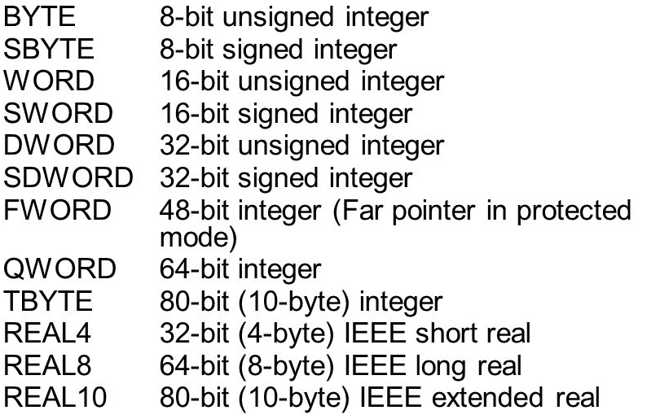
Data Types

Slide 11
Declaring Data
Data definition statement
Format: [name] directive initializer [, initializer] [;comment]
Examples
value1 BYTE ‘A’
list BYTE 10, 20, 30, 40

